Slide 1


WHO IS THE REAL KING
Alvaro del Cerro - DataScience

Slide 2




INDEX
INTRODUCCION
HIPOTESIS
EXPLORACION
CONCLUSIONES

Slide 3



INTRODUCCION

Slide 4





HIPOTESIS

Slide 5
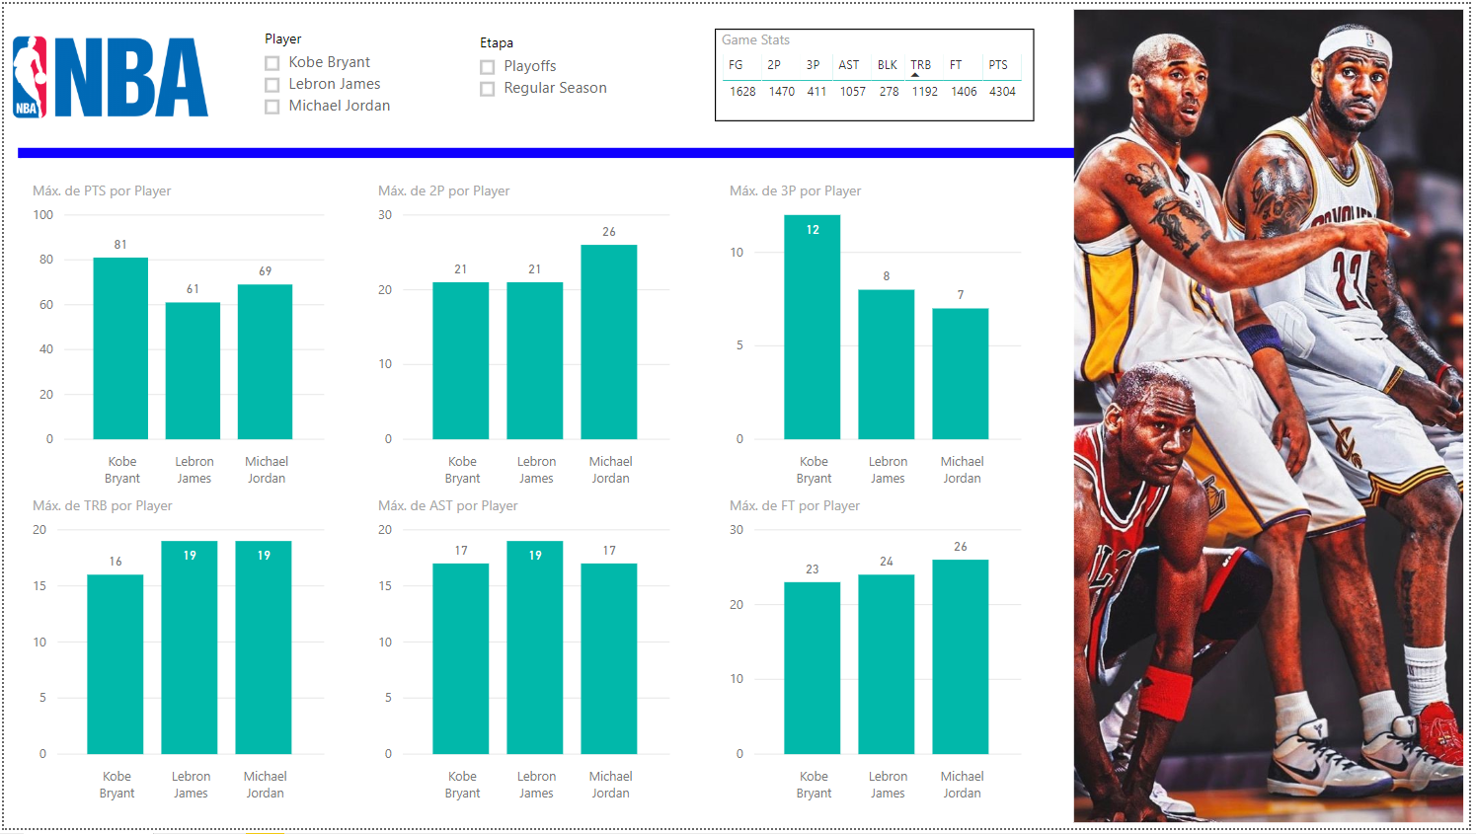

Slide 6
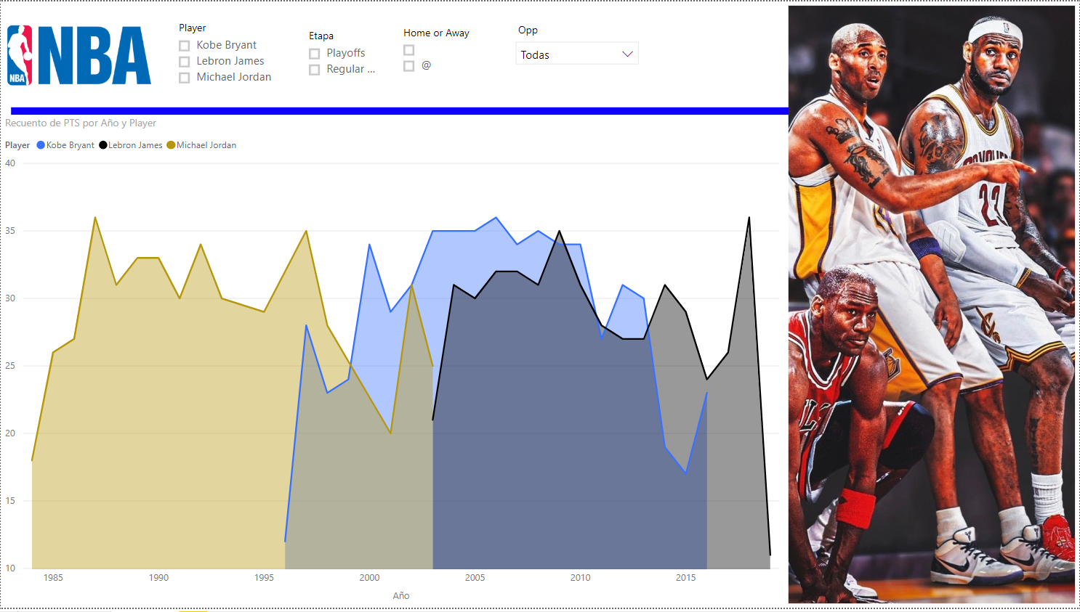

Slide 7
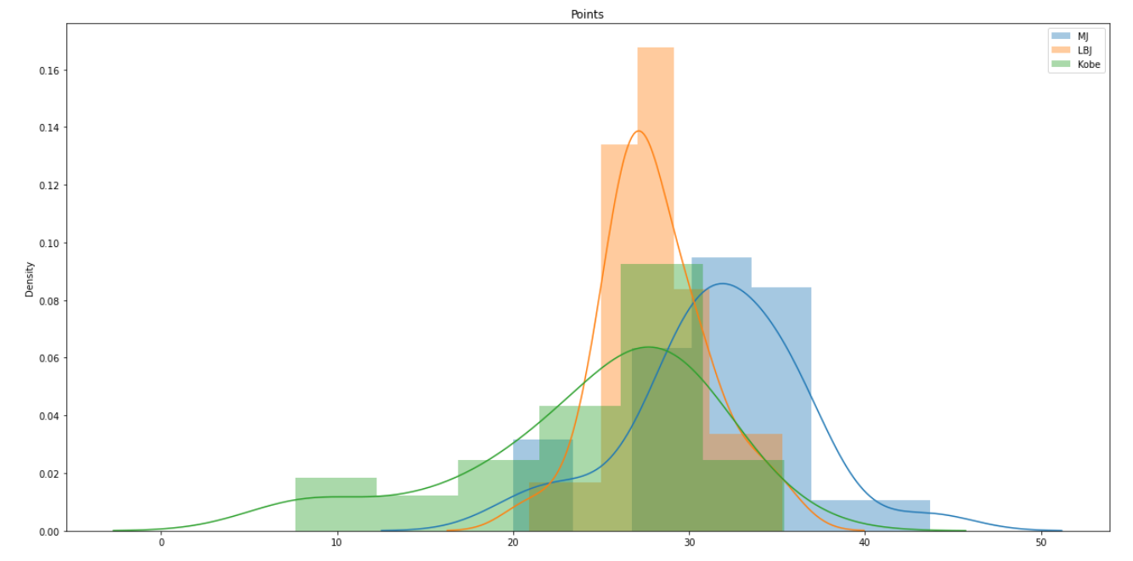

Slide 8
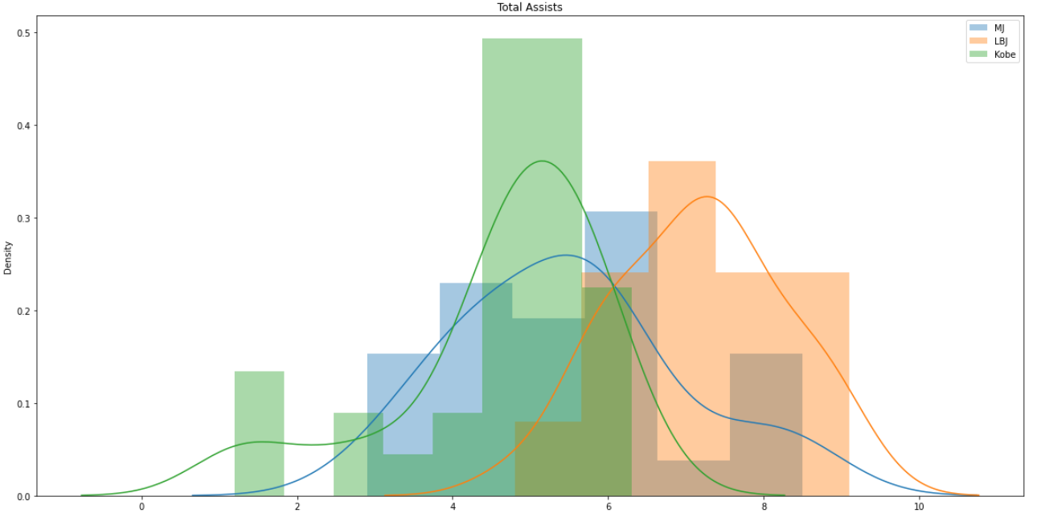

Slide 9
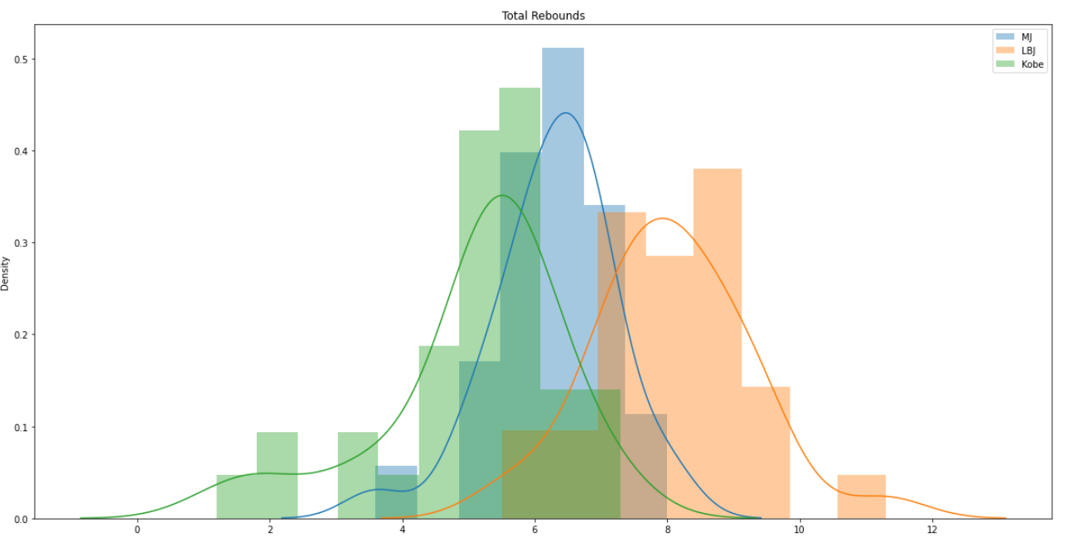

Slide 10
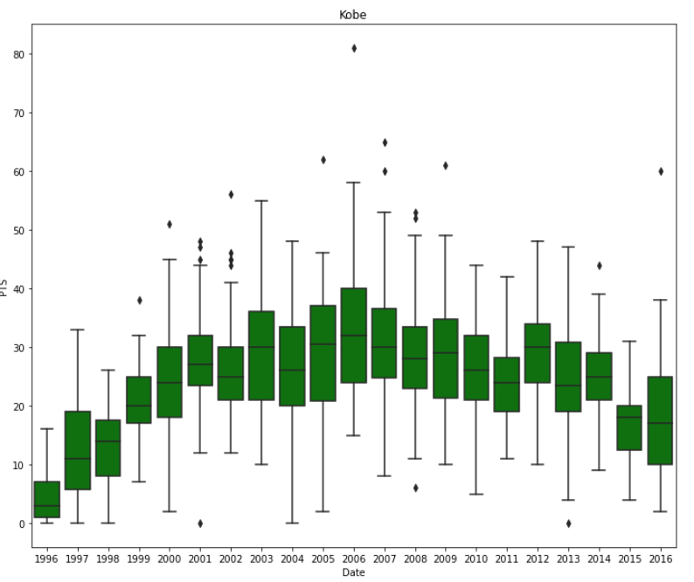
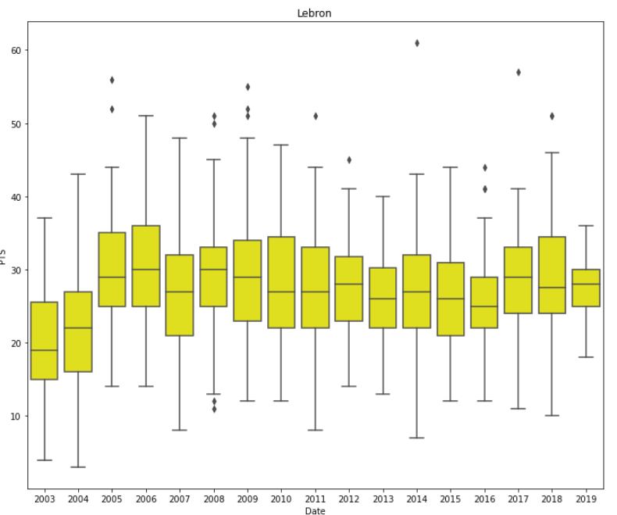
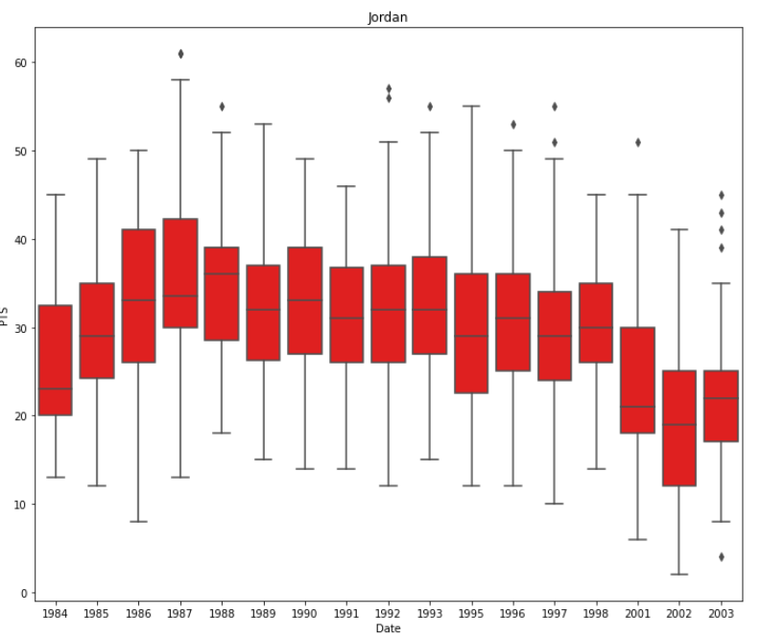

Slide 11
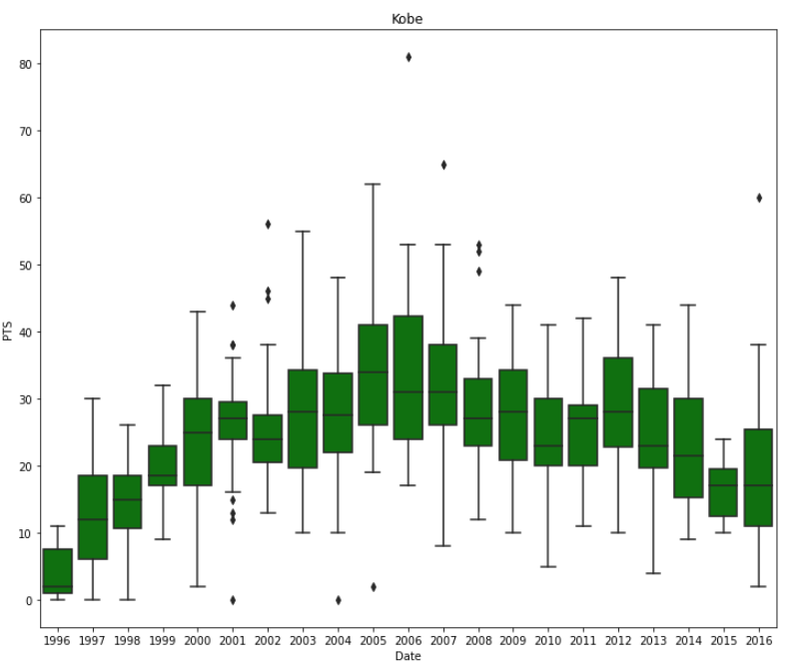
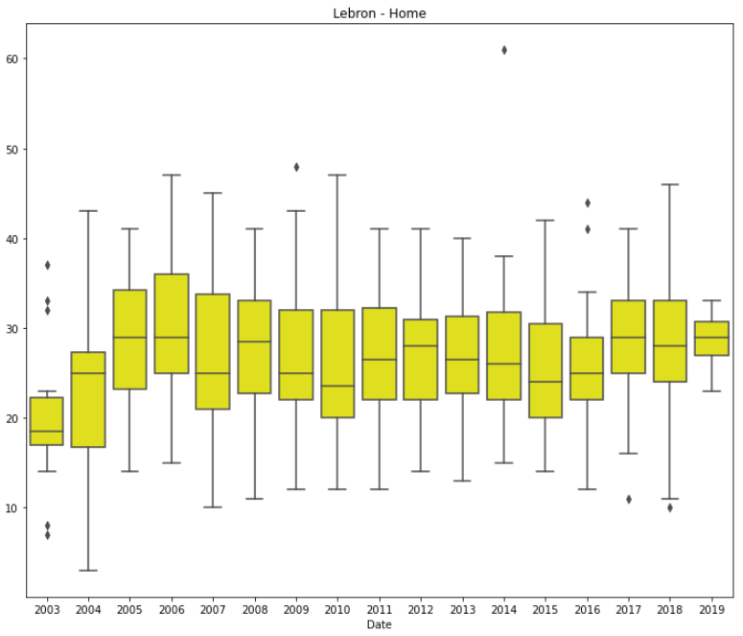
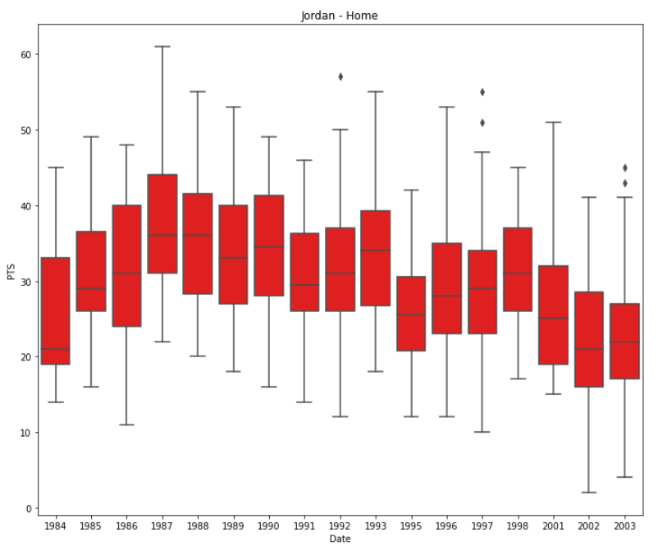

Slide 12
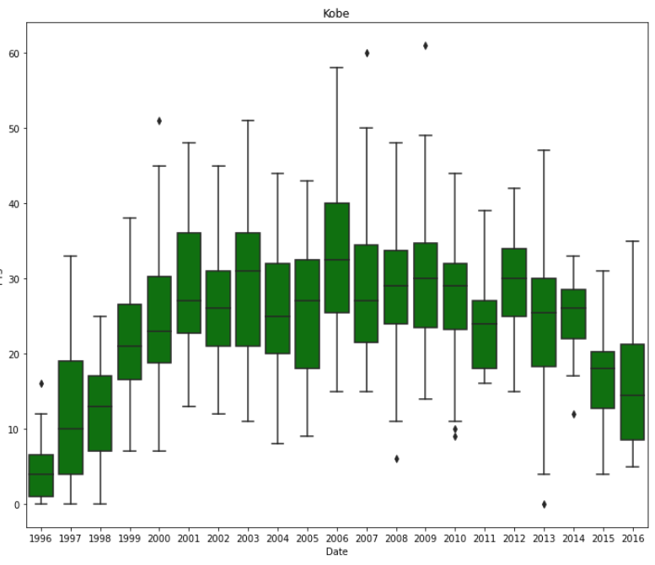
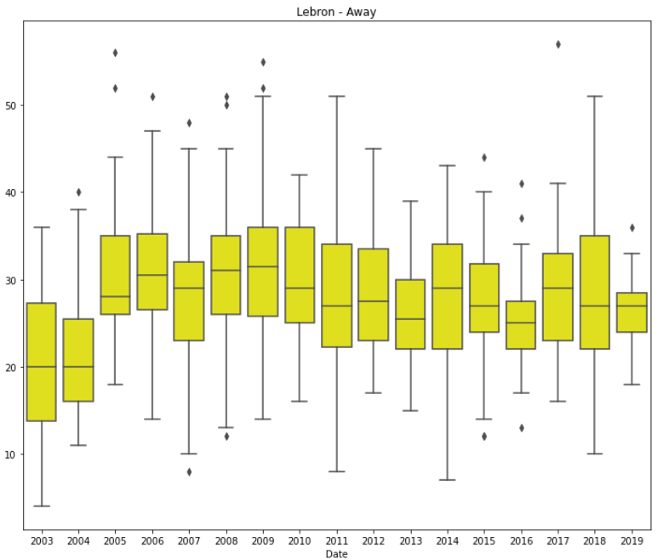
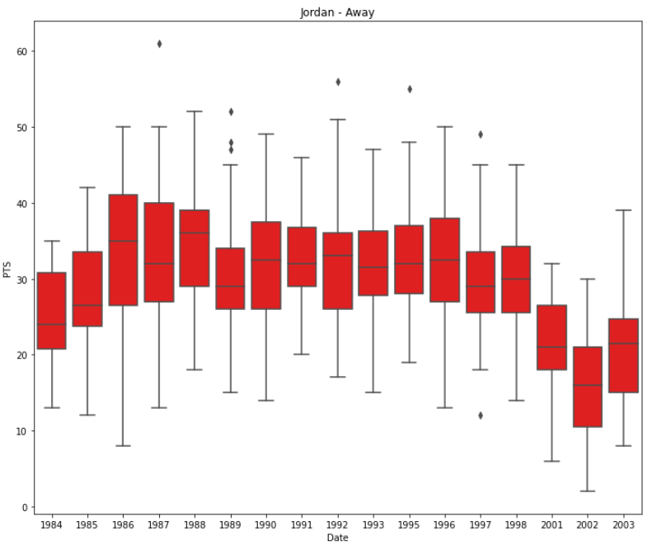

Slide 13
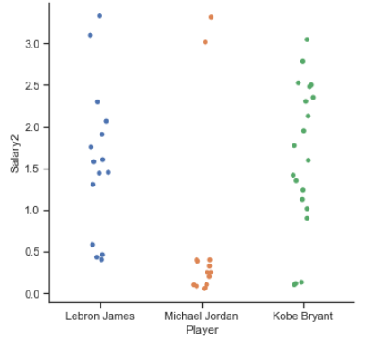
SALARIO
 | LEBRON | JORDAN | BRYANT
MIN | 4.018.920 | 550.000 | 1.015.000
MAX | 33.285.709 | 33.140.000 | 30.453.805
TOTAL | 237.020.472 | 93.285.000 | 328.238.062
246.178.546

Slide 14




CONCLUSION
%

Slide 15


